Slide 1
CircularCityChallenge
Creating a Next Generation Participatory Contest for Young People to integrate Circularity in School Curricula
SYNYO GmbH
Dr. Antonija Bogadi| Project Lead
Vienna, Austria | 23–28 April 2023
EGU23 week

Slide 2
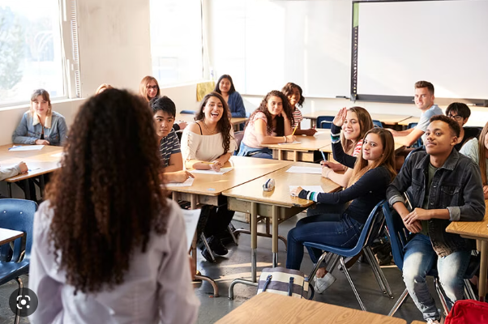
The purpose of CircularCityChallenge project
The CircularCityChallenge project started in May 2022.
It is funded by ERA-NET Urban Transformation capacities from EU H2020 research and innovation program in order to:
create a curriculum for high school students about sustainability and circular economy,
pilot the contest–based curricula, and
connect students with local policymakers.
*World Employment and Social Outlook 2018: Greening with jobs International Labour Office – Geneva: ILO, 2018
Notes:
The project started in May 2022.
It is funded by ERA-NET Urban Transformation capacities from EU H2020 research and innovation program to create -

Slide 3
The purpose of CircularCityChallenge project
Why do we do this?
Imbalances persist between the skills offered and the skills needed for the green transition. This skills mismatch is identified as an obstacle to the greening of the economy in 21 of 27 countries surveyed.*
18 million
more jobs will result from implementing the Paris Agreement on Climate Change & a shift to a greener economy goal by 2030.
24 million jobs will be created and 6 million will be lost in this transition.*
1.2 billion
jobs globally depend on a stable and healthy environment. Industries like agriculture, fisheries, and forestry, as well as tourism and pharmaceuticals, depend on natural environmental processes.*
*World Employment and Social Outlook 2018: Greening with jobs International Labour Office – Geneva: ILO, 2018

Slide 4
The challenge
How to create relevant curricula on sustainability and circular economy within various needs and constraints?
Although I want to my students prepare for work and their role in society, I‘m overburdened with existing curricula and don‘t have time for additional work.
I need good circular economy policies because they offer businesses and the government a clear opportunity for long-term growth.
We should teach models of production and consumption that involve circulating existing materials and products for as long as possible.
I want my ideas on how to make society better to be heard.
I want to put my effort into relevant issues. I need to understand what are my future job opportunities in the green industry.
I‘m not an expert in circular economy nor sustainability, how can I teach that?
I need future employees to know about the circular economy because it has the potential to unlock billions in economic growth and play a key role in protecting our planet.
STUDENT
POLICY MAKER
TEACHER
ENTERPRENOUR
EXPERT
Notes:
But then this challenge appeared – interviews and workshops results revealed very different needs – experts, students, teachers, policy makers, city representative, private companies involved in circulartiy …
How to unite all of these perspectives, and needs? How to understand interdependencies, and interconnections? How to teach kids that what they do matters, and that they are heard?
How not to burden already burdened teachers?
How to propose policies that matter?
How to gain the big picture, but understand the local barriers and needs for change?
And all of that in the spare time of students and teachers?

Slide 5
CircularCityChallenge: the approach
Teaching about sustainability issues and circular economy through systems thinking lens
systems thinking + inquiry-based learning + contest
Notes:
And the we realized that we need system thinking

Slide 6
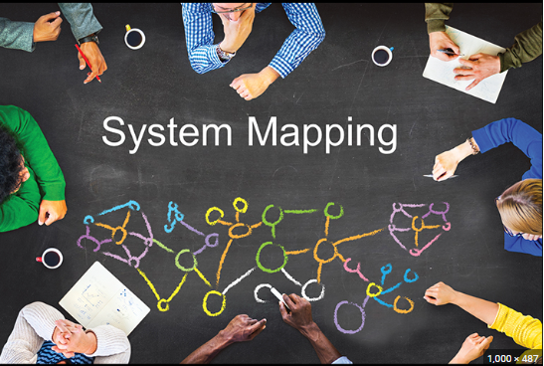
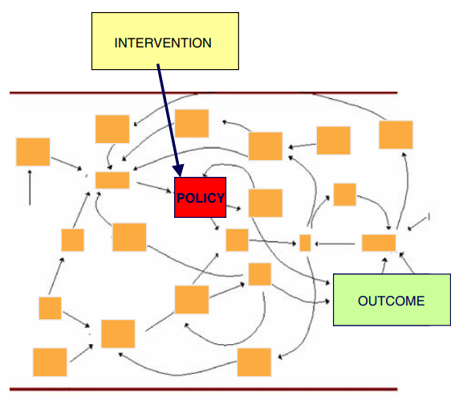
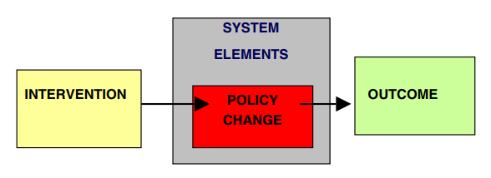
CircularCityChallenge: the approach
Teaching about sustainability issues and circular economy through systems thinking lens
System thinking is a powerful skill that can help students understand how different parts of a system interact with each other and how they can work together for
meaningful environmental action.*
This skill will help students to become better problem solvers, critical thinkers, and decision-makers.
* Graefe, Abigail Noble. "Assessing the potential benefits of learning about environmental issues through a systems thinking pedagogy." (2010).
Notes:
And the we realized that we need system thinking

Slide 7
CircularCityChallenge: the approach
Teaching about sustainability issues and circular economy through systems thinking lens
Inquiry-based learning allows schools and teachers to easily lead students through complex sustainability issues more effectively, without the need for extensive sustainability knowledge.
The CCC platform will provide comprehensible and ready-to-use educational toolkits.
Notes:
And the we realized that we need system thinking

Slide 8
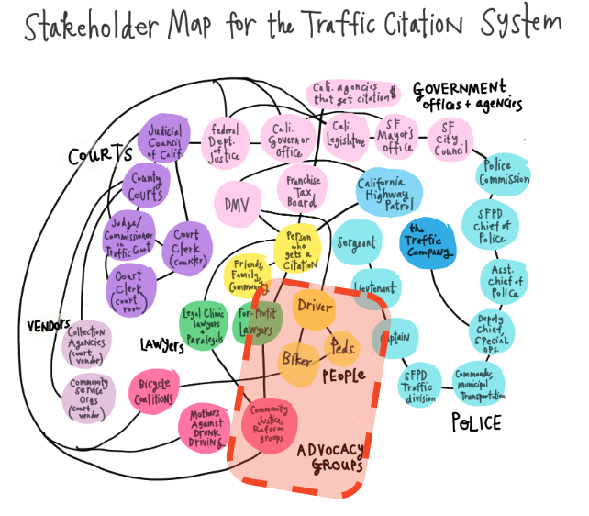
CircularCityChallenge: the approach
The CircularCityChallenge pilot contest
Through a pilot participatory contest, CCC amplifies the perspective of the young.
STEP 1
IDENTIFY THE CHALLENGE
Find a circular challenge in your city
and organise your team of three students
CCC will equip them with the tools to identify local challenges, to find their own impact, to connect with relevant stakeholders and spread their ideas beyond school boundaries.
STEP 2
FIND YOUR IMPACT
Observe and map the system
around your challenge
STEP 3
ENVISION CIRCULAR FUTURES
Find a better way! Rewrite the rules!
STEP 4
DEVELOP YOUR INTERVENTION – ACTION/PLAN
Design and test your circular idea
STEP 5
SHARE YOUR IDEAS
Tell us your story & submit!
Notes:
And this is how were gonna do the pilot contest, inquiry based learning …

Slide 9
CircularCityChallenge: the approach
The CircularCityChallenge pilot contest
STEP 6
AWARD CEREMONY FOR ALL PARTICIPANTS WITH INTERNATIONAL JURY
Vienna, October 2024.
Notes:
And this is how were gonna do the pilot contest, inquiry based learning …

Slide 10
CircularCityChallenge: outcomes
Flexible concept
problem-based learning
cross-subject collaboration within the school
science fairs
Project Weeks
Green Weeks
after-school activities
homework
Summer schools workshops
seminars
Relevant students’
competencies
systems thinking
critical thinking
creativity
problem-solving
communication
collaboration
learning about sustainability and circular economy
social responsibility
information about the green jobs industry career opportunities
Support for teachers
handbooks and tools for teaching topics on the circular economy
learning outcomes in line with national requirements
information about the green jobs industry and career opportunities in the next 10 years

Slide 11
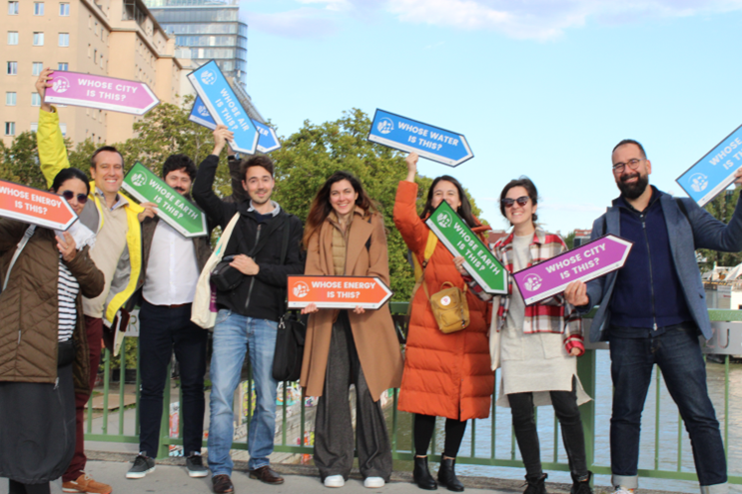
JOIN US!
Pilot contest duration: September 2023 – July 2024
Impact: 100 schools, 20 city level policymakers, 8 countries
antonija.bogadi@synyo.com
https://project.circularcitychallenge.eu/

